Slide 1
Computer Organization & Design
Computer Organization & Design
lab7
CPU design-instruction set extension

Slide 2
Course Outline
Environment
Task
Principles
Implementation
Notes:
Rudimentary logic functions=基本的逻辑函数

Slide 3
Goal
1. Usage of register transfer control
2. The core of CPU: the relation of instruction execution and datapath control
3. Design datapath and controller
4. Design testing program

Slide 4
Course Outline
Environment
Task
Principles
Implementation
Notes:
Rudimentary logic functions=基本的逻辑函数

Slide 5
Task
1. Extend the CPU instruction set of Exp06
Redesign the datapath and controller
To be compatible with that of Exp05
To substitute the core of datapath and controller of Exp05
To include at least the following instructions
R-Type：add, sub, and, or, xor, nor, slt, srl*, jr, jalr, eret；
I-Type： addi, andi, ori, xori, lui, lw, sw, beq, bne, slti
J-Type： J, Jal*；
Implement based on Exp06
2. Design instruction set testing schema
3. Design instruction set testing program

Slide 6
Course Outline
Environment
Task
Principles
Implementation
Notes:
Rudimentary logic functions=基本的逻辑函数

Slide 7
CPU organization
Digital circuit
General circuits that controls logical event with logical gates --Hardware
Computer organization
Special circuits that processes logical action with instructions -Software
Data input
Control unit
Control signals
Datapath
Data output
Status input
Status signals
Control output

Slide 8
Control signals
To be campatible with Exp06, what datapath and control signals should we add?
信号 | 源数目 | 功能定义 | 赋值0时动作 | 赋值1时动作
ALUSrc_B | 2 | Choice for B port of ALU | choose register B | Choose 32-bits immediate（after extension）
RegDst | 2 | Choice for write address for register | Choose rt | Choose rs
MemtoReg | 2 | Choice for register write-data | Choose data for memory | Choose ALU output
Branch | 2 | Choose beq target address | PC+4 | Branch address（Zero=1）
Jump | 2 | Choose jump target address | J target address | Output is decided by Branch
RegWrite | - | Register write control | Register write disabled | Register write enabled
MemWrite | - | Memory write control | memory write disabled | memory write enabled
MemRead | - | Memory read control | memory read disabled | memory read enabled
ALU_Control | 000- 111 | 3-bits ALU control | Refer to Lab4 | Lab4

Slide 9
Truth table for control signals
Rewrite the truth table based on the new datapath
OP | Reg Dst | ALU Src | Mem toReg | Reg Write | Mem Read | Mem Write | Branch | Jump | ALU _{op1} | ALU _{op0}
R-格式 000000
I-格式LW
I-格式SW
I-格式beq
J-格式
Rewrite truth table
Do we need to add more control signals？
Do we need ALU_{OP}？

Slide 10
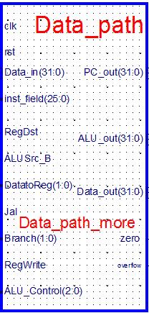
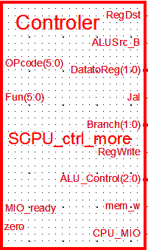
Redesign the interface of datapath and controller：
Redesign the interface
Add more control signals after extension
Datapath interface is as right figure:
Symbol file：Dataa_path_more.sym
Controller interface is as follows:
Symbole file：SCPU_ctrl_more.sym

Slide 11
Interface of datapath and controller
module SCPU_ctrl_more( input[5:0]OPcode, //OPcode
input[5:0]Fun, //Function input MIO_ready, //CPU Wait ……
output reg mem_w,
output reg [2:0]ALU_Control,
output reg CPU_MIO
);
endmodule
module Data_path_more( input clk, //寄存器时钟
input rst, //寄存器复位
input[25:0]inst_field, //指令数据域
……
output[31:0]ALU_out,
output[31:0]Data_out,
output[31:0]PC_out
);
endmodule
Notes:
module Data_path( input clk, //寄存器时钟
input rst, //寄存器复位
input[25:0]inst_field, //指令数据域
input RegDst,
input ALUSrc_B,
input MemtoReg,
input Jump,
input Branch,
input RegWrite,
input[31:0]Data_in,
input[2:0]ALU_Control,
output[31:0]ALU_out,
output[31:0]Data_out,
output[31:0]PC_out
);
endmodule

Slide 12
Course Outline
Environment
Task
Principles
Implementation
Notes:
Rudimentary logic functions=基本的逻辑函数

Slide 13
CPU controller extension
-extend CPU function of exp06

Slide 14
Project：OExp07-ExtSCPU
To include at least the following instructions
R-Type：add, sub, and, or, xor, nor, slt, srl*, jr, jalr, eret；
I-Type： addi, andi, ori, xori, lui, lw, sw, beq, bne, slti
J-Type： J, Jal*；
To substitute and verify the new CPU
To substitute the SCPU module of Exp06
To substitute SCPU_ctrl module of Exp06
To substitute Data_Path module of Exp06
Top is the same as Exp05
name：Top_OExp06_ExtSCPU.sch
The symbol of CPU needs to be modified
CPU function testing
Design testing program (MIPS assembler program) to test

Slide 15
Key problems
Design datapath for extended instruction set
Redesign the symbol for the new interface
Extend the schematic file based on Exp05
Design controller based on the new datapath
Redesign the symbol for the new interface
Use HDL structural description
Design CPU module
Design CPU module based on new datapath and controller
Rebuild CPU symbol
Simulation for the new module
Do simulation for DataPath and controller separately
Substitute CPU and sub-modules
After do simulation correctly, substitute CPU, datapath and controller modules

Slide 16
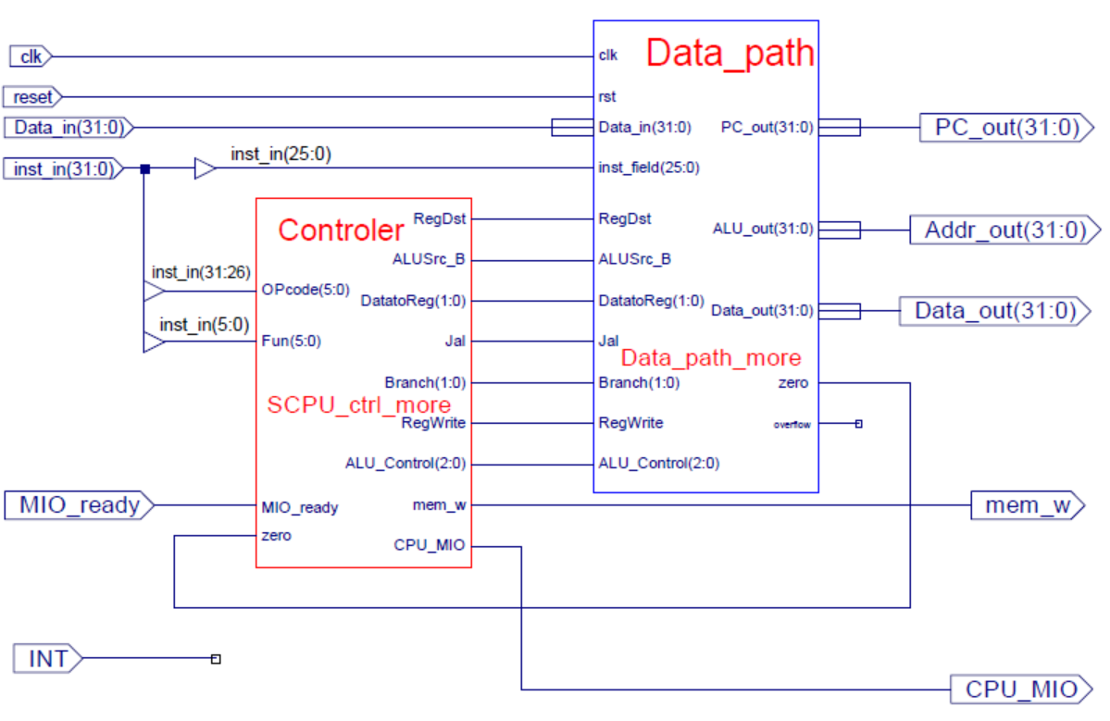
CPU module after extension

Slide 17
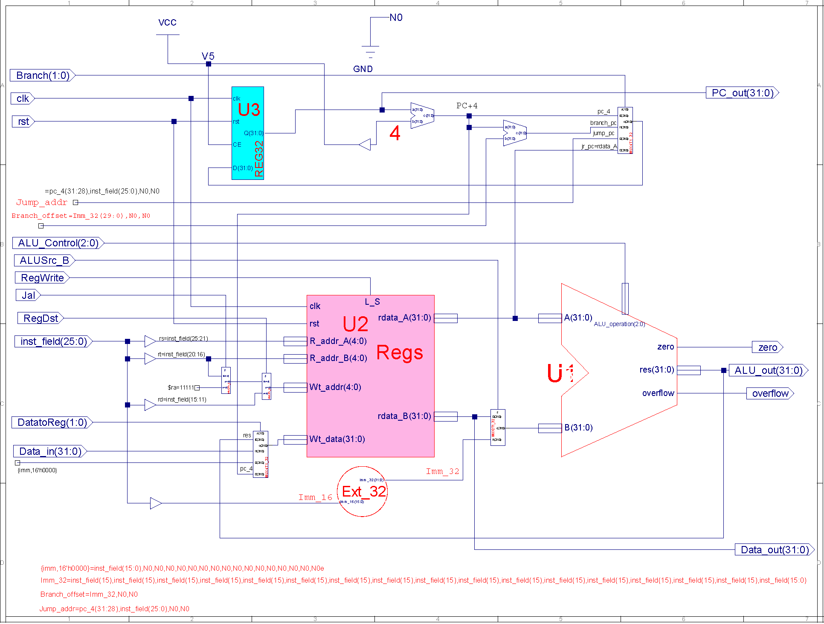
Datapath design

Slide 18
Controller structure description
`define CPU_ctrl_signals {RegDst,ALUSrc_B,MemtoReg,RegWrite,MemRead,MemWrite,Branch,Jump, ALU_Control，… …………}
assign mem_w = MemWrite&&(~MemRead);
always @* begin
case(OPcode)
6‘b000000: //ALU
case(Fun)
6'b100000: begin CPU_ctrl_signals = ?; end //add
6'b100010: begin CPU_ctrl_signals = ?; end //sub
……
default: begin CPU_ctrl_signals = ?; end;
endcase
6'b100011: begin CPU_ctrl_signals = ?; end //load
6'b101011: begin CPU_ctrl_signals = ?; end //store
……
default: begin CPU_ctrl_signals = ?; end
endcase
end

Slide 19
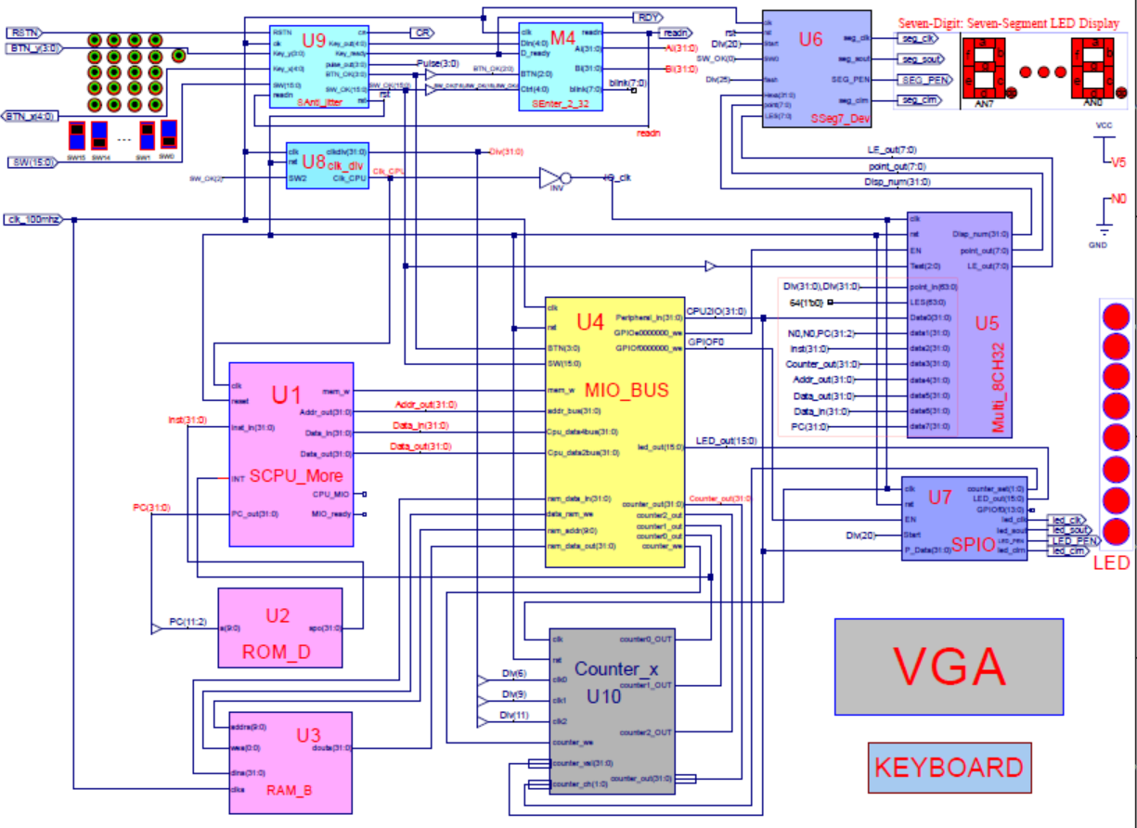
Top level of Exp07
CPU逻辑符号不同

Slide 20
CPU debug and test
debug
SCPU_ctrl_more simulation
Design simulation code to simulate*
Data_path_more simulation
Design simulation code to simulate*
Substitution
Substitute the corresponding module of Exp06 after correct simulation
Use DEMO program to observe the running of controller
DEMO is different from the previous lab
也可自行设计
memory_initialization_radix=16;
memory_initialization_vector=
08000008, 00000020, 00000020, 00000020, 00000020, 00000020, 00000020, 00000020, 3c03f000, 3c04e000, 3c088000, 2014003f, 3c06f800, 00000827, 0001102a, 202affff, ac660004, 8c650000, 00a52820, 00a52820, ac650000, 21290001, ac890000, 8c0d0014, 8c650000, 00a52820, 00a52820, ac650000, 8c650000, 00a85824, 21ad0001, 15a00001, 0c000037, 8c650000, 20120008, 0252b020, 02569020, 00b25824, 11600005, 11720009, 20120008, 1172000a, ac890000, 08000018, 15410002, 00005027, 014a5020, ac8a0000, 08000018, 8e290060, ac890000, 08000018, 8e290020, ac890000, 08000018, 8c0d0014, 014a5020, 354a0001, 22310004, 02348824, 01224820, 15210001, 21290005, 8c650000, 00a55820, 016b5820, ac6b0000, ac660004, 03e00008;

Slide 21
Design test record form
CPU instruction testing result record
Design the record form by yourself

Slide 22
Thoughts
What’s the problem when using two-level decoder when designing the controller for instruction set extension？
Do we need to add more control signals for bne instruction？
Do we need to add new datapath for andi instruction？

Slide 23
END

